Slide 1

UCS1405 – SOFTWARE ENGINEERING
Software Process
Dr.K.Madheswari
ASP/CSE

Slide 2
Learning Objective
To understand software process
To understand the generic framework activities that are present in every software process
To understand process models and process patterns

Slide 3
Overview
Introduction to software process
People involved
Importance
Steps involved
Work product
Assessment Mechanism
Process models

Slide 4
Software Process
When you work to build a product or system, it’s important to go through a series of predictable steps—a road map that helps you create a timely, high-quality result.
The road map that you follow is called a “software
process.”

Slide 5
People Involved
Software engineers and their managers adapt the process to their needs and then follow it.
In addition, the people who have requested the software have a role to play in the process of defining, building, and testing it.

Slide 6
Importance
Because it provides stability, control, and organization to an activity that can, if left uncontrolled, become quite chaotic.
A modern software engineering approach must be “agile.”
It must demand only those activities, controls, and work products that are appropriate for the project team and the product that is to be produced.

Slide 7
Steps Involved
At a detailed level, the process that you adopt depends on the software that you’re building.
One process might be appropriate for creating software for an aircraft avionics system, while an entirely different process would be indicated for the creation of a website.

Slide 8
Work Product
From the point of view of a software engineer, the work products are
– the programs documents, and data that are produced as a consequence of the activities and tasks defined by the process.

Slide 9
Assessment Mechanism
The quality, timeliness, and long-term viability of the product you build are the best indicators of the efficacy of the process that you use.

Slide 10
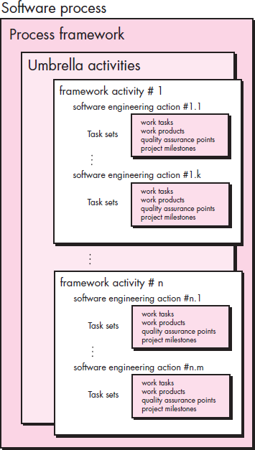
Generic Process Model
A generic process framework for software engineering defines five framework activities
communication
planning
modelling
construction
deployment

Slide 11
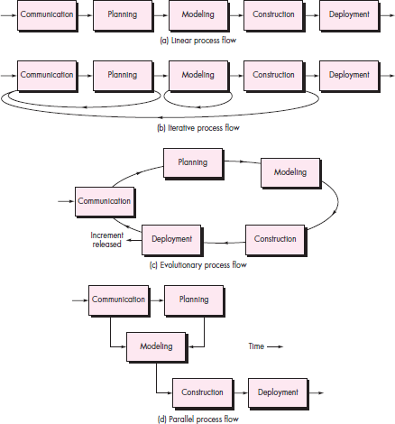
Process Flow

Slide 12
Generic Process Model
Defining a Framework Activity
Identifying a Task Set
Process Patterns

Slide 13
Process Assessment and Improvement
Standard CMMI Assessment Method for Process Improvement (SCAMPI)—provides a five step process assessment model that incorporates five phases: initiating, diagnosing, establishing, acting and learning.
CMM-Based Appraisal for Internal Process Improvement (CBA IPI)—provides a diagnostic technique for assessing the relative maturity of a software organization; uses the SEI CMM as the basis for the assessment [Dun01]

Slide 14
Process Assessment and Improvement
SPICE—The SPICE (ISO/IEC15504)standard defines a set of requirements for software process assessment. The intent of the standard is to assist organizations in developing an objective evaluation of the efficacy of any defined software process. [ISO08]
ISO 9001:2000 for Software—a generic standard that applies to any organization that wants to improve the overall quality of the products, systems, or services that it provides. Therefore, the standard is directly applicable to software organizations and companies. [Ant06]

Slide 15
Prescriptive Process Model
Waterfall model
Incremental Process model
Evolutionary Process model
Prototyping
Spiral model
Concurrent model

Slide 16
Specialized Process Model
Component based development—the process to apply when reuse is a development objective
Formal methods—emphasizes the mathematical specification of requirements
AOSD—provides a process and methodological approach
for defining, specifying, designing, and constructing aspects

Slide 17
Agile Development
Extreme Programming
Adaptive Software Development
Scrum
Dynamic Systems Development
Crystal
Feature Drive Development (FDD)
Lean Software Development (LSD)
Agile Modeling (AM)
Agile Unified Process (AUP)

Slide 18
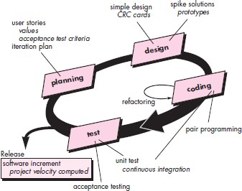
Extreme Programming

Slide 19
Summary
Introduction to software process
People involved
Importance
Steps involved
Work product
Assessment Mechanism
Process models

Slide 20
Check your understanding
What are framework activities?
What is the work product of software process?

Slide 21
Reference
Roger S. Pressman, “Software Engineering – A Practitioner’s Approach”, Seventh Edition, Mc Graw-Hill International Edition, 2010.

Slide 22
Thank you

